Slide 1
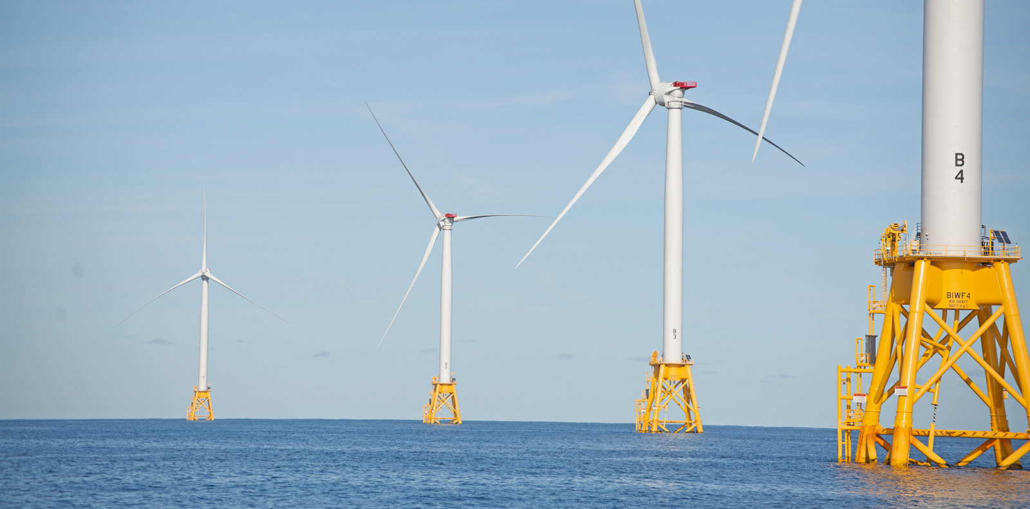
Offshore Wind in the U.S.
Past, Present, and Future
October 19, 2021
Teresa R. Christopher
Former White House Ocean Policy Advisor
Founder & Principal, T.R.Christopher Strategies

Slide 2
The Ocean as a Climate Solution
The Ocean as a Climate Solution
  Ocean absorbs 25% of all CO₂ emissions
  Captures 90% of the additional heat generated from those emissions
  Ocean can provide key source of renewable energy through Offshore Wind
Offshore wind could be major component of clean energy economy in U.S.
Offshore wind is stronger and more consistent than onshore wind
In the U.S., offshore wind could provide 2,000 GW of energy
  2x the present generation of the entire U.S. electric grid
Ability to create jobs and bolster economy

Slide 3
Offshore Wind in the United States:
Brief History
Energy Policy Act of 2005 (EPAct) authorizes OCS renewable energy program
National Ocean Policy/Ocean Planning (2009/2010)
U.S. Department of the Interior announce final regulations (2009)
  Provide framework for issuing leases, easements, and rights-of-way for OCS activities that support production & transmission of offshore wind
Smart from the Start / Proposed Transmission Backbone for East Coast (2010)
BOEM first “Call for Information” for Offshore Wind (2011)
Nation's first competitive lease sale (2013)
Block Island Wind Farm 30MW operational (2016)
Cape Wind (lease terminated 2017)
Coastal Virginia Offshore Wind 12MW operational (June 2020)
Vineyard Wind (MA) Final Federal Approval(May 2021)
Notes:
US offshore wind stalled for a decade due to litigation, protracted permitting, energy markets/cost, interest group opposition
Slow to get starter – as of the end of 2020 we only have 2 commercial projects and 7 turbines in the water
Energy markets, cost competitiveness, protracted permitting processes, lack of science and data concerning cumulative impacts on the environment, needing to conduct studies during specific times of year, interest group opposition, lawsuits, jurisdiction complications, and wildlife impacts have all contributed to delays or barriers to expeditiously expanding offshore wind in U.S. waters.
ugust 18, 2011, BOEM published a "Call for Information and Nominations for Commercial Leasing for Wind Poweron the OCS Offshore Rhode Island and Massachusetts“
July 31, 2013, BOEM auctioned the Rhode Island/Massachusetts WEA

Slide 4
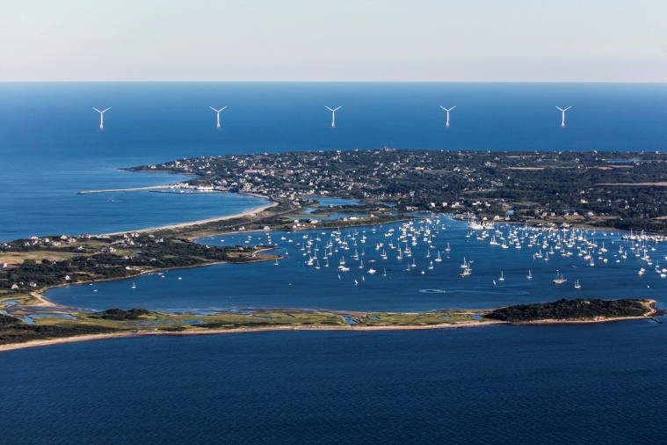
Challenges and Barriers
Complex offshore governance and regulatory requirements
Inadequate Staffing and Resources at Regulatory Agencies
User Conflicts
  Navigation
  Military Uses
  Commercial Fishing
  Coastal Homeowners/NIMBYs (Visual Impacts)
Interest Group Opposition/Litigation
Transmission
  Grid Capacity
  Limited Interconnectivity
Long Time Horizons
  Protracted due to litigation
  Approx. 7 years from auction to operational
Ecological Impacts and Limited Scientific Data
Lack of Support Infrastructure Domestically
  Manufacturing
  Skilled workers
Technological Limitations
Jones Act Compliance
Notes:
Offshore areas often support multiple industries and fragile marine environments, all of which need to be considered and protected when proposing, developing, and constructing an offshore wind project. requires involvement from multiple federal agencies, state and local jurisdictions
MOST ARE SOLVABLE

Slide 5
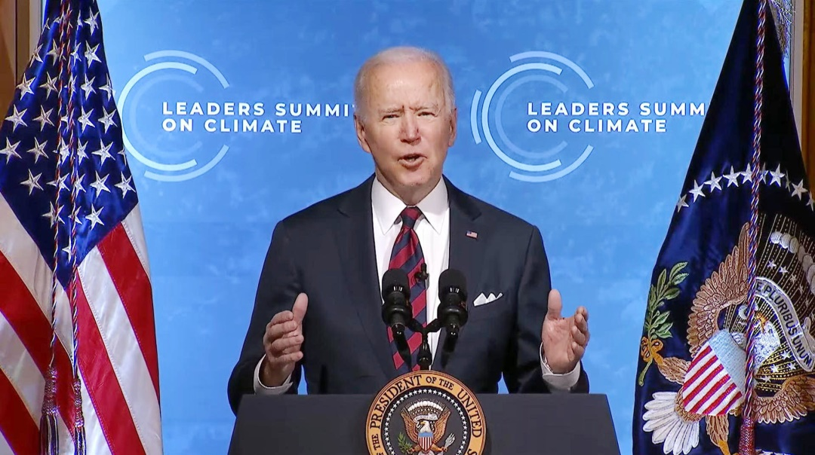
Putting Wind in the Sails
  States have been leading
  Driving industry forward with offshore wind targets
  8 East Coast States alone have set targets of approx. 37GW
Biden Administration set National Goals
  Net Zero Emissions by 2050
  30GW of Offshore Wind
  by 2030
Notes:
need to address these barriers with pragmatic solutions and continue to advance policies that allow for the growth of the industry.

Slide 6
East Coast State Commitments
State | Renewable Goals | Offshore Wind Goals (MW)
Massachusetts | 35% by 2030 | 3,200
Rhode Island | 100% by 2030 | Unspecified
Connecticut | 48% by 2030 | 2,300
New York | 70% by 2030 | 9,000 by 2035
New Jersey | 50% by 2030 | 7,500 by 2035
Maryland | 50% by 2030 | 7,000
Virginia | 30% by 2030 | 5,212
North Carolina | 70% reduction of green house gas emissions by 2030 | 2,800 by 2030; 8,000 by 2040

Slide 7
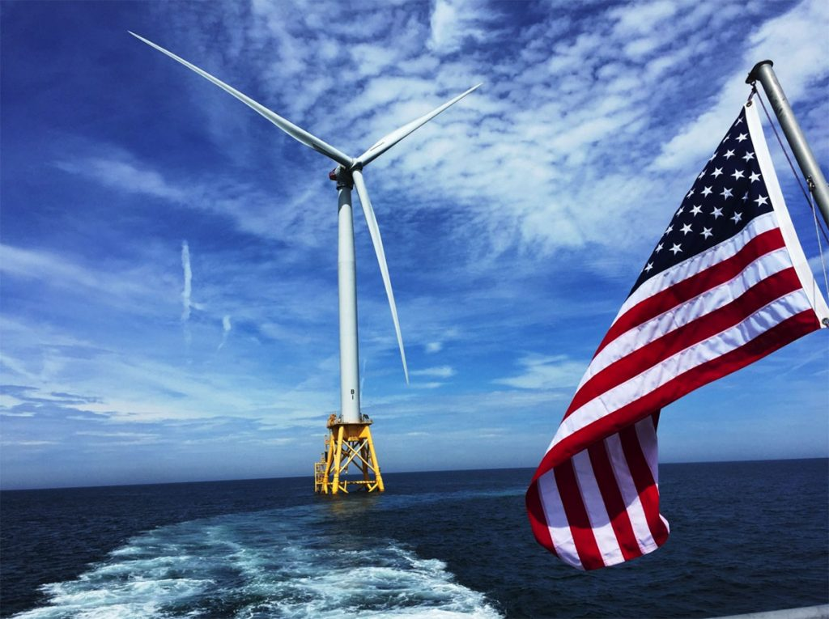
Offshore Wind in the United States: Current State
16 active commercial wind energy leases
  (when operational would power ~8 million homes)
8 competitive lease sales complete
10 site assessment plans approved
Activity on all Coasts
Notes:
So where are we today?

Slide 8
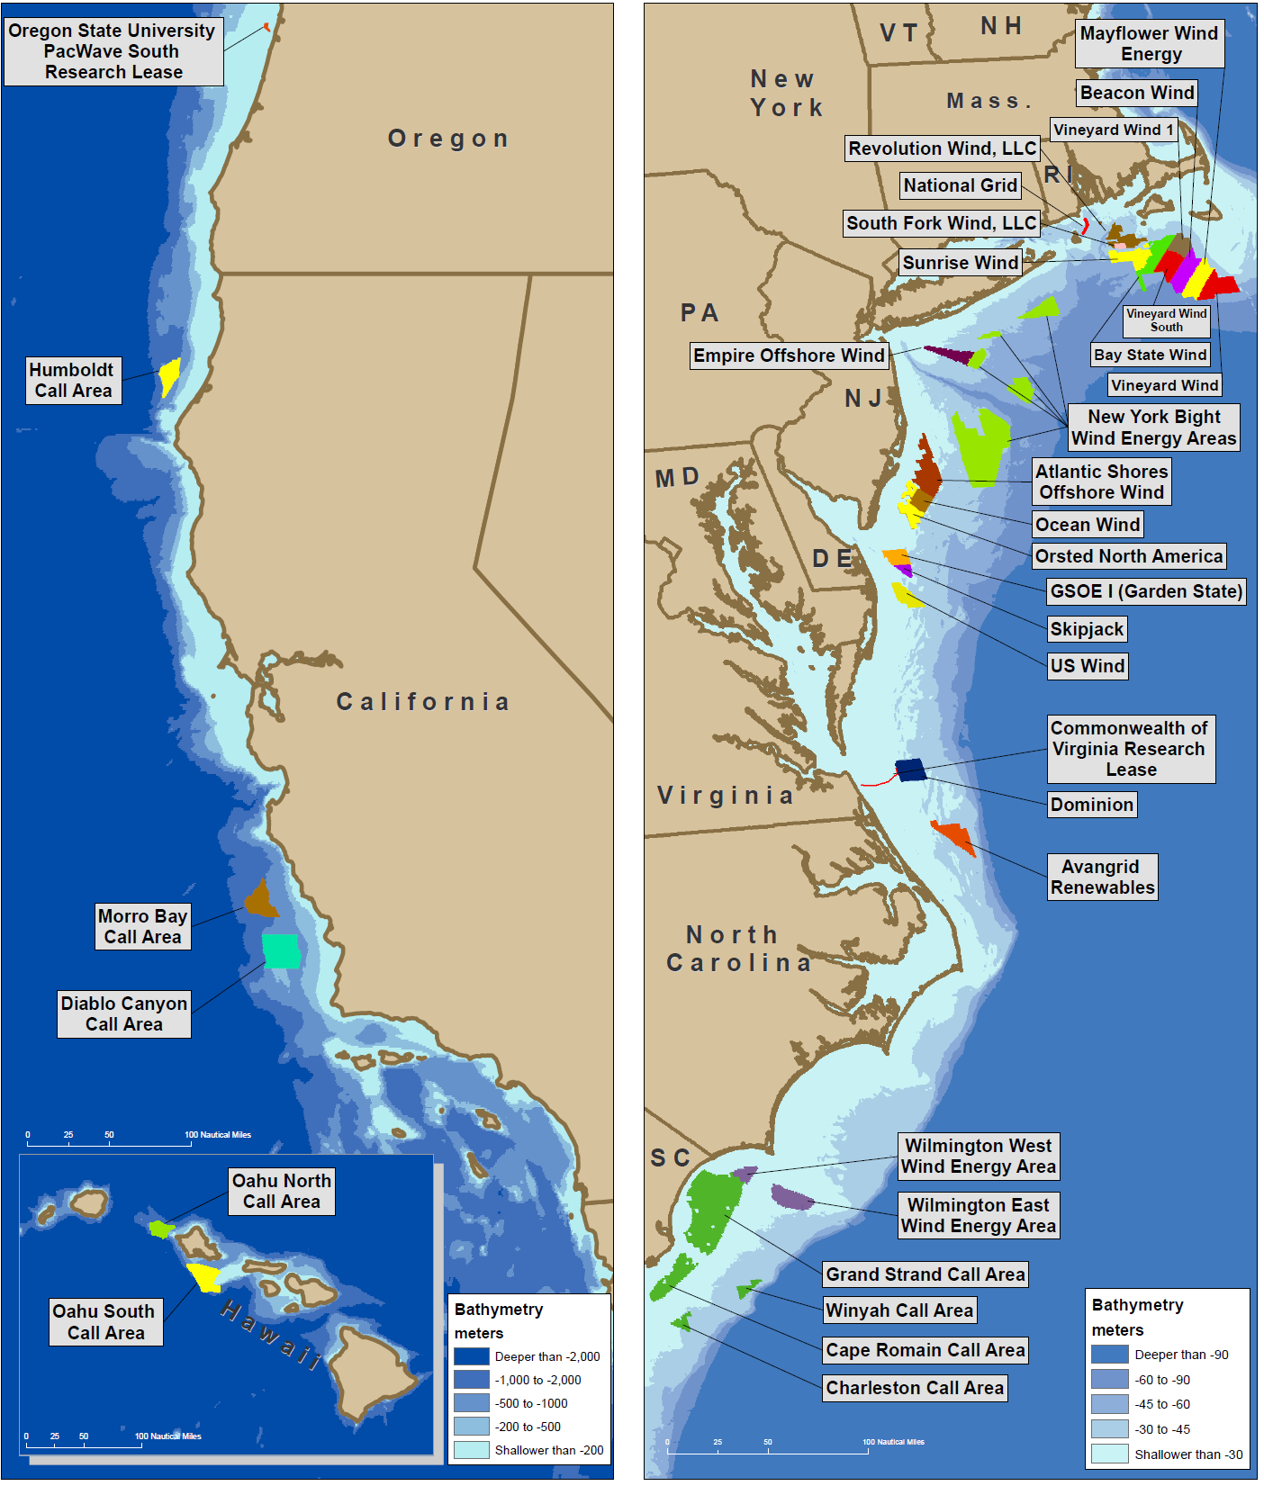
Current U.S. Leases and Wind Areas
Notes:
As of last week – Sec. of the Interior announced seven new offshore wind lease sales by 2025 – NY Bight, Gulf of Maine, Central Atlantic, California, Carolinas, Gulf of Mexico, Oregon
US East Coast
-most commercial wind energy leases are on east coast
-NY/NJ area auction expected in next few months
-Maine has proposed floating project
NC/SC call areas
West Coast
California has a wind energy area identified on the central coast / 7 companies expressed interest/ auction in mid-2022
Oregon has Task Force
Washington State has a potential project with the Quinault Tribe
Gulf Coast States have set up a BOEM Task Force
Hawaii has call areas

Slide 9
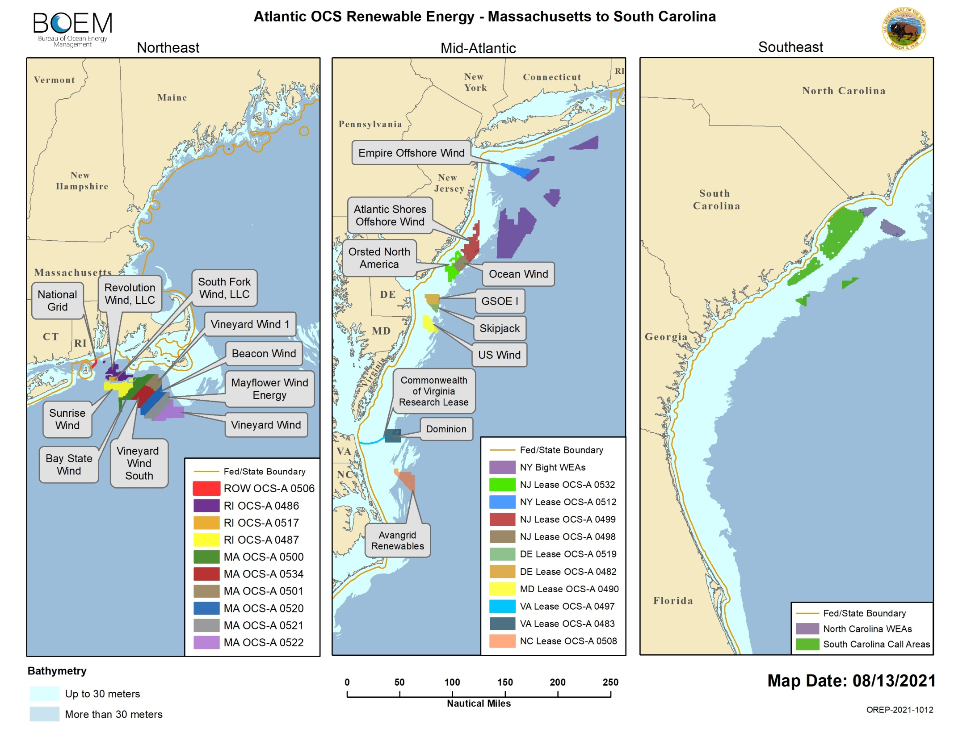

Slide 10
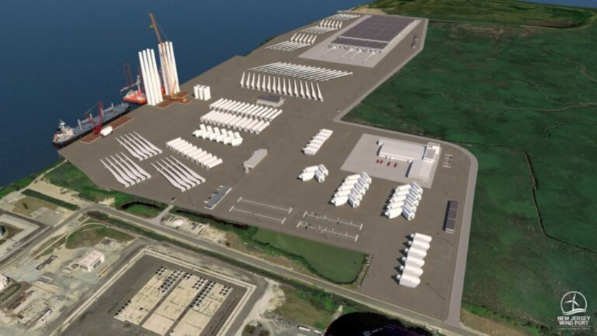
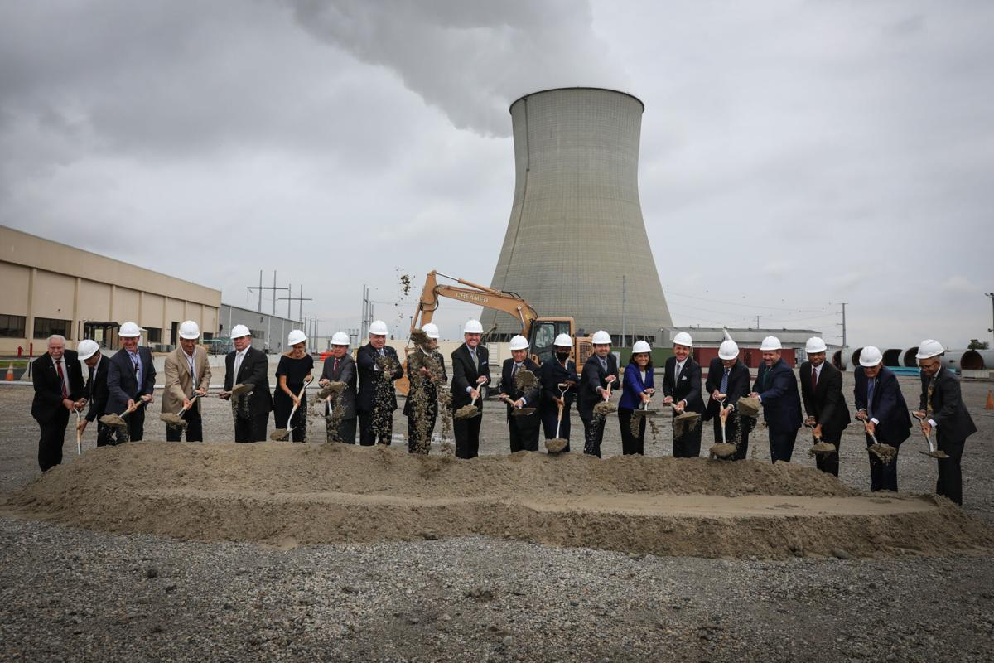
Bolstering the Economy
Potential to provide over 80,000 jobs per year through development, construction and operation between 2025-2035
Already seeing investments in port infrastructure, job training, manufacturing, ship building
States vying for opportunities
  NJ Wind Port (first facility purpose built)
  NC, VA, MD created Southeast and Mid-Atlantic Regional Transformative Partnership for Offshore Wind Energy Resources (SMART-POWER)
  NY Port of Coeymans
  Not just coastal states
Notes:
The New Jersey Wind Port will be located on an artificial island on the eastern shores of the Delaware River, southwest of the City of Salem. the first facility purpose-built for staging, assembly, and manufacturing activities related to offshore wind projects on the US East Coast.
Executive Order follows a bipartisan memorandum of understanding among the governors of North Carolina, Maryland and Virginia in October 2020 that created the Southeast and Mid-Atlantic Regional Transformative Partnership for Offshore Wind Energy Resources (SMART-POWER). The SMART-POWER MOU provides a framework for the three states to cooperatively promote, develop and expand offshore wind energy and the accompanying industry supply chain and workforce.

Slide 11
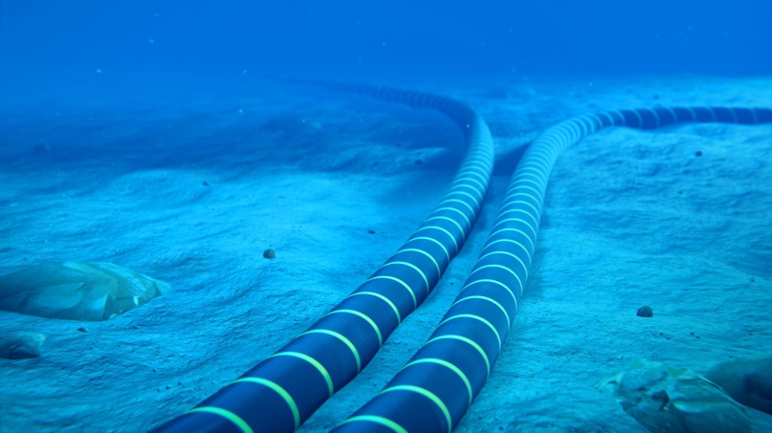
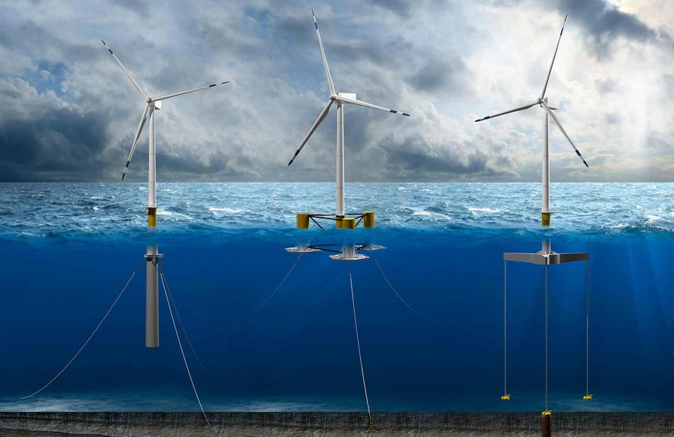
Advancing Offshore Wind: Recommendations
Federal Leadership
  Appoint Offshore Wind Czar in Executive Office of the President to coordinate across agencies and provide day to day leadership
Increase Staffing and Resources at BOEM and other Regulatory Agencies
Offshore Wind Transmission Master Plan
  Plan and invest in Offshore Grid NOW
  develop master plan or regional master plans
  a high capacity transmission “backbone” or a “hub and spoke” model
Continue to invest in technology
  Floating
  Waste recycling
Notes:
develop a cohesive, strategic offshore wind transmission master plan or regional master plans.

Slide 12
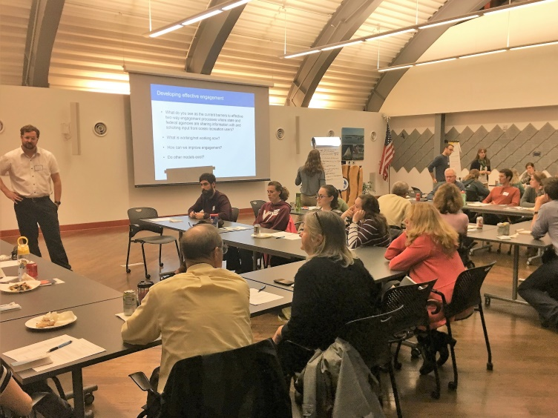
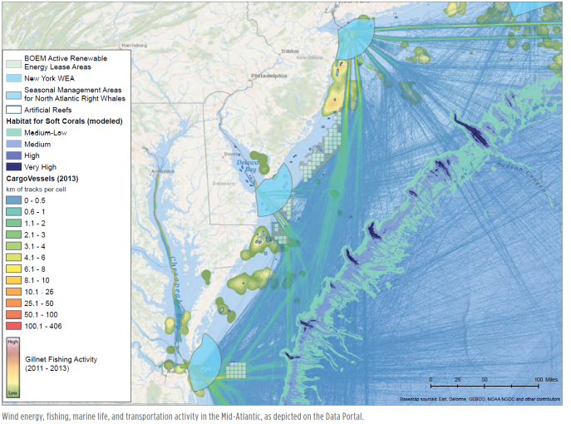
Advancing Offshore Wind: Recommendations
Address User Conflicts Up Front
  Regional Ocean Planning
  Look for synergies to co-locate uses
Continue to invest in baseline science
Congress should establish dedicated fund to support research and mitigate environmental impacts
Address cumulative impacts
Ensure that the communities hosting receive some of benefits

Slide 13
Advancing Offshore Wind: Recommendations
Build domestic capability and capacity of workforce and supply chain
  Invest in workforce training programs
  Invest in manufacturing programs that create and enhance domestic supply chains

Slide 14
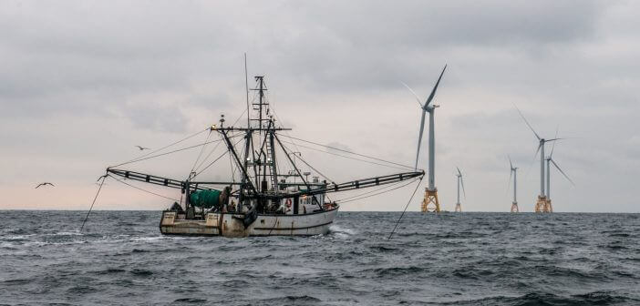
Thank you!

